Slide 1
FIFA 21 Players
Data Analysis
DATA SCIENCE MID-PROJECT
Cleaning, exploration, insights and a Streamlit web app
Epsilon AI | 18,979 players | 77 columns
Eng / Saleh Abdel Raouf Hussein
1 / 28

Slide 2
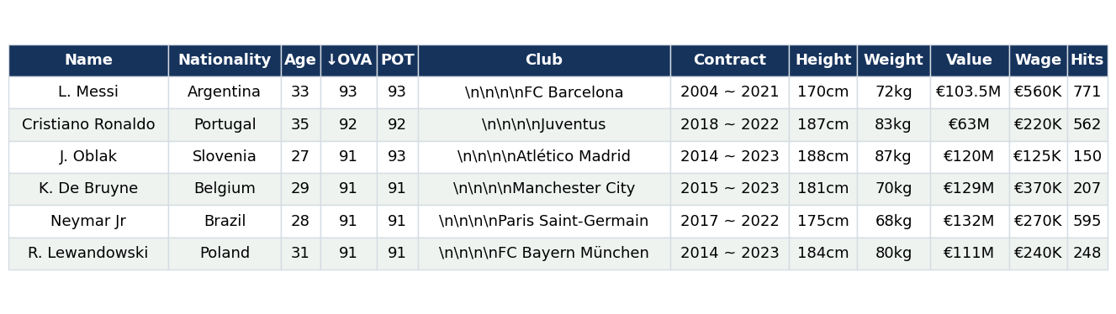
Dataset Preview: Raw Data Sample
Raw file, 18,979 rows by 77 columns. Note the hidden line breaks in Club, money stored as text (€103.5M), and units inside Height and Weight.
Eng / Saleh Abdel Raouf Hussein
2 / 28

Slide 3
Agenda
01 Domain & Dataset
02 Data Understanding
03 Data Problems
What the data is about
Columns and their meaning
What was wrong with the raw data
04 Data Cleaning
05 Exploration & Insights
06 Streamlit App & Conclusion
How each problem was fixed
Key findings
Live dashboard and summary
Eng / Saleh Abdel Raouf Hussein
3 / 28

Slide 4
Domain and Dataset
18,979
77
164
681
Players (rows)
Columns
Nationalities
Clubs
Domain
Source
Why it fits
Football (soccer) video-game data: every player in EA Sports FIFA 21 with ratings, skills, contract and market value.
Raw FIFA 21 players file, collected from the sofifa website and published on Kaggle.
Real-world messy data: mixed units, text numbers, hidden characters and missing values.
Eng / Saleh Abdel Raouf Hussein
4 / 28

Slide 5
Project Questions
Who are the best?
Who leads?
Where is the money?
Highest-rated and highest-potential players, and the biggest growth gaps.
Which nationalities and clubs have the most and the best players.
Most valuable and highest-paid players, and the clubs with the largest wage bills.
What drives rating?
Left or right?
Which skills matter?
How age, potential, value and wage relate to overall rating (OVA).
Preferred foot share and its effect on rating.
Attributes most correlated with OVA.
Eng / Saleh Abdel Raouf Hussein
5 / 28

Slide 6
Data Understanding: Columns
Identity and bio
Ratings
Club and contract
Name, LongName, Nationality, Age, Height, Weight, Preferred Foot.
OVA (overall), POT (potential), BOV (best overall), Best Position, Positions.
Club, Contract period, Joined date, Loan Date End.
Money
Skills
Summary and fame
Value (market value), Wage, Release Clause.
29 detailed skills grouped as Attacking, Skill, Movement, Power, Mentality, Defending, Goalkeeping.
PAC, SHO, PAS, DRI, DEF, PHY, Total and Base Stats, W/F, SM, work rates, IR, Hits.
Eng / Saleh Abdel Raouf Hussein
6 / 28

Slide 7
Numerical and Categorical Columns
54
23
Numerical columns
Text (object) columns in the raw file
Numerical (54)
Text columns that need cleaning (12)
True categories and identity (11)
Ratings – ID, Age, ↓OVA, POT, BOV
Categories – Nationality, Club, Preferred Foot, Best Position, Positions, A/W, D/W
Units and money – Height, Weight, Value, Wage, Release Clause
Attributes – 34 sub-skills plus 7 group scores
Identity – Name, LongName, photoUrl, playerUrl
Dates – Contract, Joined, Loan Date End
Summary – Total Stats, Base Stats
Stars and hits – W/F, SM, IR, Hits
Core six – PAC, SHO, PAS, DRI, DEF, PHY
Eng / Saleh Abdel Raouf Hussein
7 / 28

Slide 8
Column Dictionary 1/3: Bio and Contract
Identity & Bio
Ratings & Potential
Club & Contract
ID – Unique player ID
↓OVA – Overall rating, 0 to 99
Club – Current club
Name – Short name, e.g. L. Messi
POT – Potential rating
Contract – Text, e.g. 2018 ~ 2022
LongName – Full name
BOV – Rating at best position
Joined – Date joined the club
photoUrl – Player photo link
Loan Date End – Loan end, if on loan
playerUrl – sofifa profile link
Nationality – Player country
Position
Age – Age in years
Positions – All playable positions
Value & Wages
Height – Text, e.g. 170cm
Best Position – Single best position
Value – Market value (text)
Weight – Text, e.g. 72kg
Wage – Weekly wage (text)
Preferred Foot – Left or Right
Release Clause – Buyout amount (text)
Eng / Saleh Abdel Raouf Hussein
8 / 28

Slide 9
Column Dictionary 2/3: Skill Attributes
Attacking
Movement
Mentality
Attacking – Group score
Movement – Group score
Mentality – Group score
Crossing – Crossing ability
Acceleration – Speed to top speed
Aggression – Challenge intensity
Finishing – Shot conversion
Sprint Speed – Top running speed
Interceptions – Reading passes
Heading Accuracy – Header accuracy
Agility – Direction changes
Positioning – Positioning sense
Short Passing – Short pass accuracy
Reactions – Reaction speed
Vision – Spotting passes
Volleys – Volley ability
Balance – Stability when turning
Penalties – Penalty taking
Composure – Calm under pressure
Skill
Power
Skill – Group score
Power – Group score
Defending
Dribbling – Control while running
Shot Power – Shot strength
Defending – Group score
Curve – Curving the ball
Jumping – Jump ability
Marking – Marking opponents
FK Accuracy – Free-kick accuracy
Stamina – Match endurance
Standing Tackle – Standing tackles
Long Passing – Long pass accuracy
Strength – Strength in duels
Sliding Tackle – Sliding tackles
Ball Control – General ball control
Long Shots – Accuracy from range
Eng / Saleh Abdel Raouf Hussein
9 / 28

Slide 10
Column Dictionary 3/3: GK, Summary, Core Six
Goalkeeping
Star Ratings (text, 1 to 5)
FIFA Core Six
Goalkeeping – Group GK score
W/F – Weak foot
PAC – Pace
GK Diving – Diving ability
SM – Skill moves
SHO – Shooting
GK Handling – Catching ability
IR – International reputation
PAS – Passing
GK Kicking – Kick power and accuracy
DRI – Dribbling
GK Positioning – GK positioning
DEF – Defending
GK Reflexes – Reflex saves
Work Rates (Low/Medium/High)
PHY – Physical
A/W – Attacking work rate
Summary Stats
D/W – Defensive work rate
Total Stats – Sum of 34 attributes
Base Stats – Sum of six core stats
Popularity
Hits – Page views on sofifa
Eng / Saleh Abdel Raouf Hussein
10 / 28

Slide 11
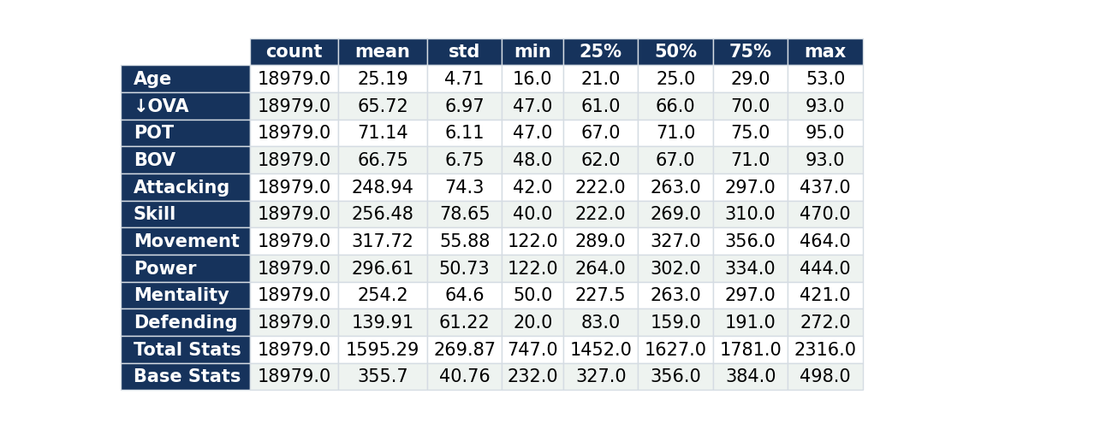
df.describe(): Numerical Columns
Eng / Saleh Abdel Raouf Hussein
11 / 28

Slide 12
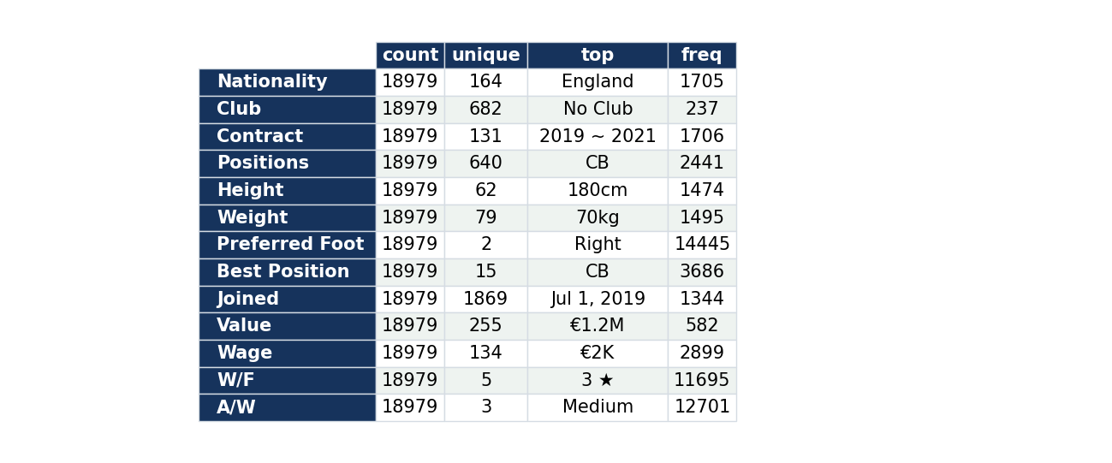
df.describe(): Categorical Columns
Eng / Saleh Abdel Raouf Hussein
12 / 28

Slide 13
Data Problems Found
Hidden characters
Text instead of numbers
Mixed units
Club has line breaks and spaces in 18,742 rows; 237 players are marked "No Club".
Value, Wage and Release Clause look like "€103.5M" and "€560K".
Height in cm or feet and inches (40 rows); Weight in kg or lbs (40 rows).
Stars as text
Missing values
Awkward formats
W/F, SM and IR hold values like "4 ★" and "4★".
Loan Date End is empty in 17,966 rows; Hits is empty in 2,595 rows.
Contract is text ("2004 ~ 2021"), Joined is text, the OVA header is "↓OVA", Hits has a K suffix.
Eng / Saleh Abdel Raouf Hussein
13 / 28

Slide 14
Data Understanding: Overview
25.2
65.7
506
0
Average age (16 to 53)
Average overall rating, OVA
Players with OVA 80 or higher
Duplicate rows
Youngest and oldest
Top rated
Checks run
R. Cherki is the youngest at 16; K. Miura is the oldest at 53.
L. Messi (93) and Cristiano Ronaldo (92).
info, describe, duplicates, missing percentages, unique values of every column.
Eng / Saleh Abdel Raouf Hussein
14 / 28

Slide 15
Data Cleaning: Steps
1 Drop
2 Club
3 Contract
ID, photoUrl, playerUrl, Loan Date End and the raw Contract column.
Strip whitespace; "No Club" becomes missing.
Split into Contract_Start and Contract_End years.
4 Units
5 Money
6 Types
Height to cm and Weight to kg, converting feet/inches and lbs.
Remove € and convert K and M to real numbers.
Stars to integers, Joined to datetime, Hits K to numbers, "↓OVA" renamed OVA.
Eng / Saleh Abdel Raouf Hussein
15 / 28

Slide 16
Cleaning Result and New Feature
Before
After
Text columns, mixed units, hidden line breaks, 77 raw columns.
Numeric and datetime columns, one unit per column, ready for statistics and charts.
New feature: difference_OVA_POT
Documented in code
POT minus OVA shows how much room each player has to grow. Largest gap: B. Arrey-Mbi, age 17, rated 60 with potential 86 (+26).
Each step is a small function (contract years, height, weight, money, hits) so the cleaning is repeatable.
Eng / Saleh Abdel Raouf Hussein
16 / 28

Slide 17
Data Analysis Steps
1 Load and inspect
2 Clean
3 Univariate
read_csv, info, describe, duplicates, missing percentages.
Fix text, units, missing values and names; add difference_OVA_POT.
Age, OVA, Height, Weight, Preferred Foot and Best Position, one at a time.
4 Bivariate
5 Multivariate
6 Dashboard
OVA against Value, Age and POT; averages by foot, nationality and club.
Correlation heatmap and OVA vs POT colored by Age.
Streamlit app with filters, KPIs and six tabs. Plot types used: histogram, box, bar, line, scatter, heatmap.
Eng / Saleh Abdel Raouf Hussein
17 / 28

Slide 18
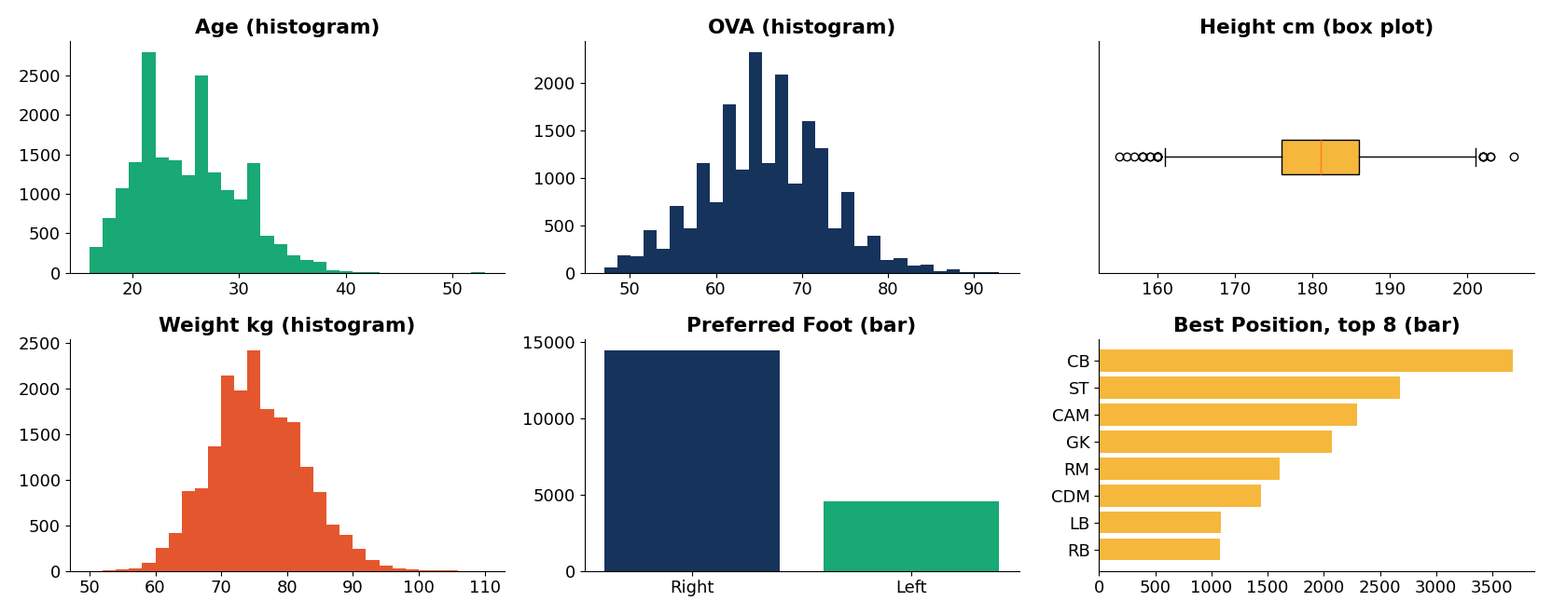
Univariate Analysis: Six Variables
Eng / Saleh Abdel Raouf Hussein
18 / 28

Slide 19
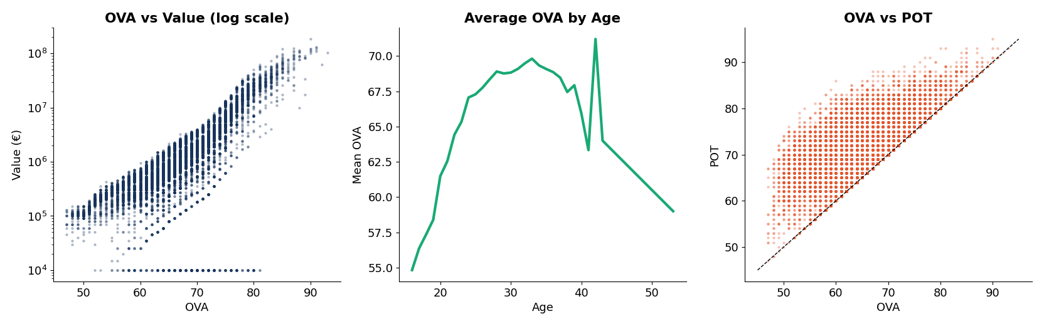
Bivariate Analysis
OVA correlates 0.55 with Value (non-linear, so a log scale is used), 0.47 with Age and 0.63 with POT. Points above the dashed line have POT higher than OVA.
Eng / Saleh Abdel Raouf Hussein
19 / 28

Slide 20
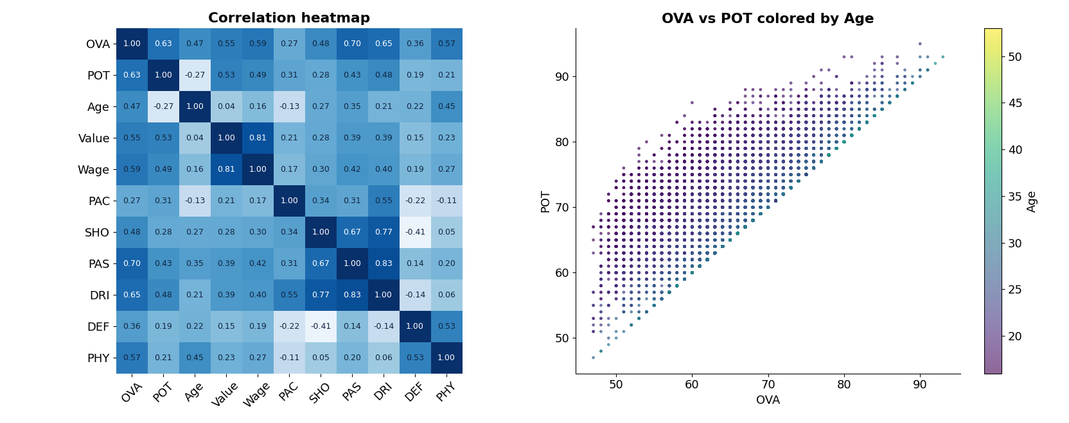
Multivariate Analysis
Eng / Saleh Abdel Raouf Hussein
20 / 28

Slide 21
Insights: Players and Ratings
67%
37
76%
of players (12,712) have POT above OVA
players have potential of 90 or more
are right-footed; 24% left-footed
Youth upside
Nationalities
The largest growth gaps belong to teenagers such as B. Arrey-Mbi, R. Richards and A. Hajdari (+26 each).
England, Germany, Spain, France and Argentina supply the most players. Among nations with 30+ players, Egypt has the highest average OVA (71.4).
Eng / Saleh Abdel Raouf Hussein
21 / 28

Slide 22
Insights: Value and Wages
€185.5M
€560K
Real Madrid
Most valuable: K. Mbappé
Top wage: L. Messi
Largest total wage bill, then FC Barcelona and Manchester City
Most valuable
Highest paid
Mbappé, then Neymar Jr (€132M) and K. De Bruyne (€129M).
Messi, then De Bruyne (€370K) and Benzema (€350K).
Eng / Saleh Abdel Raouf Hussein
22 / 28

Slide 23
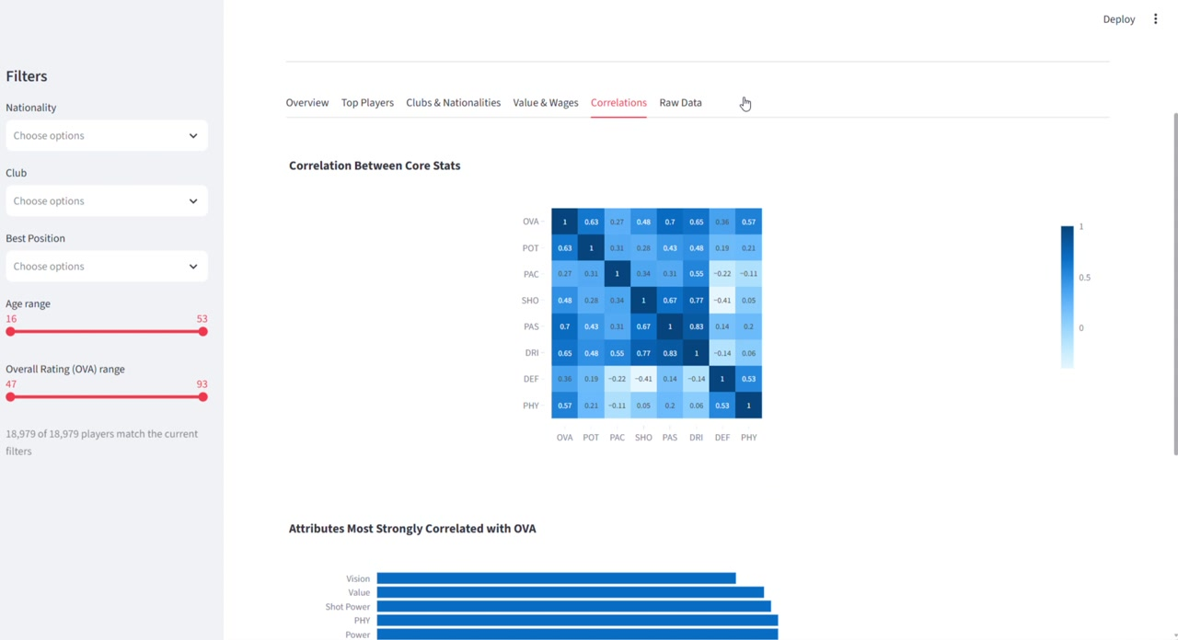
Insights: Correlations
Reactions (0.87), Base Stats (0.85) and Composure (0.70) track OVA most closely.
OVA vs POT 0.63, vs Wage 0.59, vs Value 0.55, vs Age 0.47.
Potential falls as age rises (-0.27): older players have less room to grow.
Correlations tab in the app
Eng / Saleh Abdel Raouf Hussein
23 / 28

Slide 24
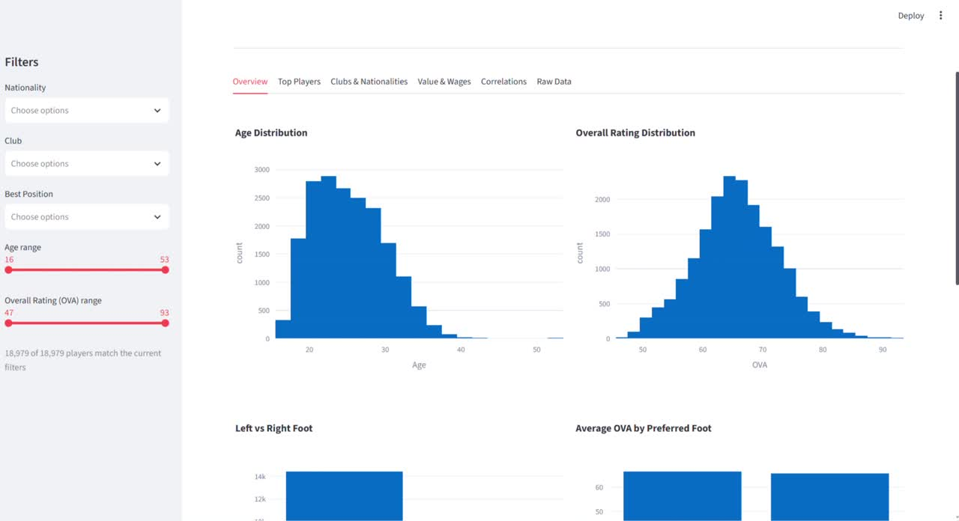
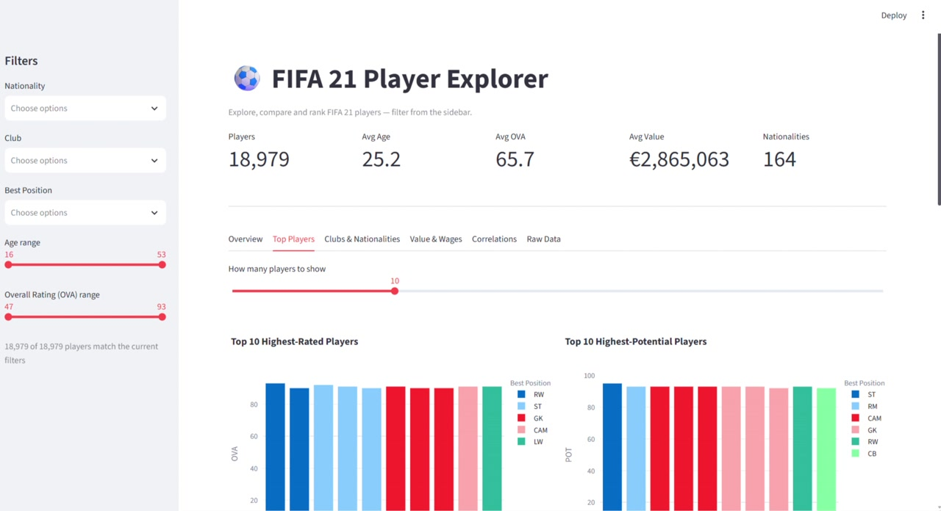
Streamlit Web App
Interactive dashboard: filters, KPI cards and six tabs
Overview tab: distributions and filters
Top Players tab: ratings and potential
Eng / Saleh Abdel Raouf Hussein
24 / 28

Slide 25
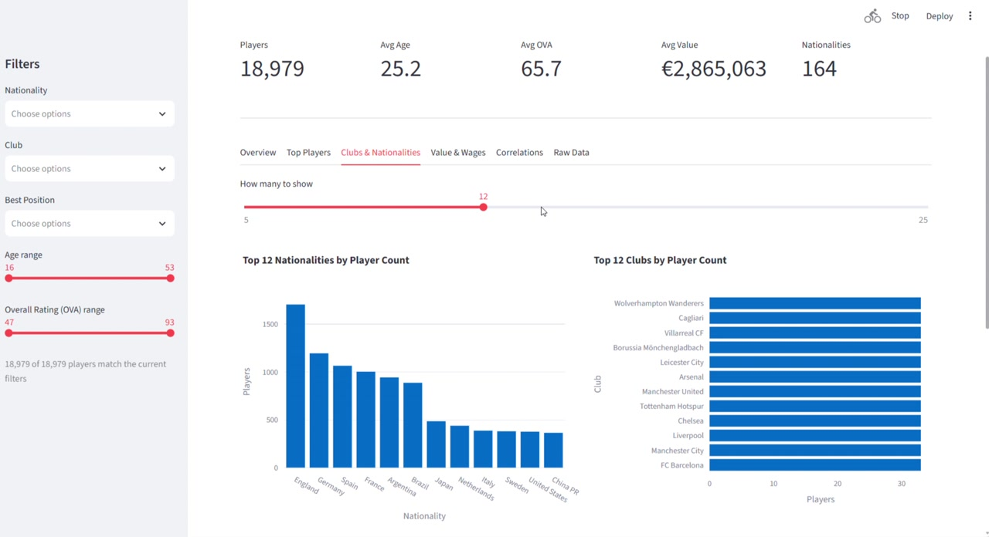
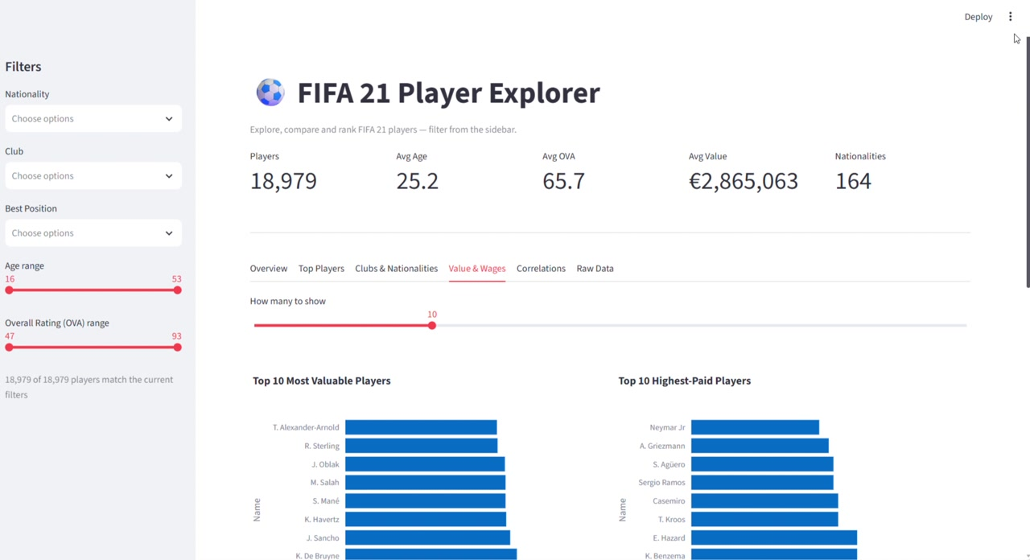
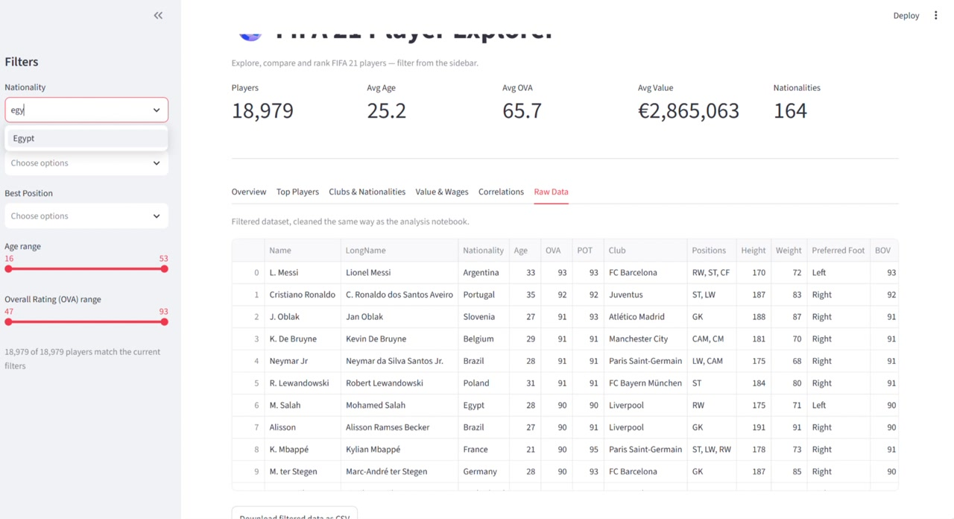
Streamlit App: More Views
Clubs and Nationalities
Value and Wages
Raw Data with CSV download
Eng / Saleh Abdel Raouf Hussein
25 / 28

Slide 26
The Story Behind the Data
1 The data
2 The clean-up
18,979 FIFA 21 players described by 77 columns: ratings, skills, contracts and money, in raw and messy form.
Text numbers, mixed units, hidden line breaks and missing values were fixed, and one new feature, difference_OVA_POT, was added.
3 The discovery
4 The takeaway
Talent is young: 67% of players can still improve and teenagers carry the biggest gaps. Money sits at the top: Mbappé is valued at €185.5M and Messi earns the top wage.
Rating follows reactions, composure and base stats more than age, and the Streamlit app lets anyone explore it.
Eng / Saleh Abdel Raouf Hussein
26 / 28

Slide 27
Key Insights
67%
+26
37
of players have POT above OVA
largest growth gap: B. Arrey-Mbi, age 17
players with potential of 90 or more
€185.5M
0.87
71.4
most valuable player: K. Mbappé
correlation of Reactions with OVA
Egypt average OVA, nations with 30+ players
Eng / Saleh Abdel Raouf Hussein
27 / 28

Slide 28
Conclusion
Data
Findings
Delivery
The raw file had text numbers, mixed units, hidden characters and missing values; all were documented and fixed.
Most players still have room to grow, young talents carry the biggest gaps, and rating follows reactions, composure and base stats.
A Streamlit app turns the cleaned data into a filterable dashboard for exploring players, clubs and money.
Eng / Saleh Abdel Raouf Hussein
28 / 28

